Slide 1
Chapter 12 pages 634-642
Cache Memory
Notes:
This is a summarized presentation of Cache Memory from Chapter 12.
If you want more detail, please review the powerpoint named Chapter 12-detailed.
However, the information that you will need for the quiz or the final will be in this presentation.
Chapter 12 goes into details on the microcode level that exists between the circuits at Level 1 and the machine code at Level 3, however we will only review cache memory here.
I encourage you to read all of Chapter 12.

Slide 2
6.3 The Memory Hierarchy
Cache Memory
Faster memory is more expensive than slower memory
Memory is organized in a hierarchical fashion
  Small, fast storage elements kept in the CPU
  Larger, slower main memory accessed through the data bus
  Larger, permanent storage - disk and tape drives still further from the CPU
Notes:
Generally speaking, faster memory is more expensive than slower memory.
To provide the best performance at the lowest cost, memory is organized in a hierarchical fashion.
Small, fast storage elements are kept in the CPU; larger, slower main memory is accessed through the data bus.
Larger, (almost) permanent storage in the form of disk and tape drives, is still further from the CPU.

Slide 3
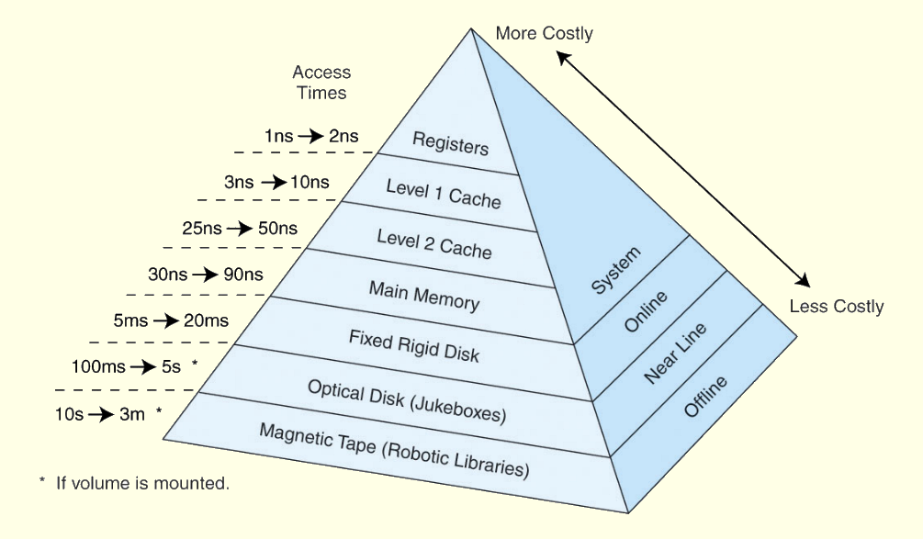
6.3 The Memory Hierarchy
This storage organization can be thought of as a pyramid:
Notes:
This pyramid is a very good example of storage organization. It goes from the registers which are very fast to optical disks and tape. Note as the speed increases – so does the cost.

Slide 4
6.3 The Memory Hierarchy
Cache Memory
To access a particular piece of data
  CPU sends a request to its nearest memory, usually cache
  If data not in cache-
  then main memory is queried
  If the data not in main memory-
  then request goes to disk
Once data is located
  then data, and many nearby data elements are fetched into cache memory
Notes:
To access a particular piece of data, the CPU first sends a request to its nearest memory, usually cache.
If the data is not in cache, then main memory is queried. If the data is not in main memory, then the request goes to disk.
Once the data is located, then the data, and a number of its nearby data elements are fetched into cache memory.

Slide 5
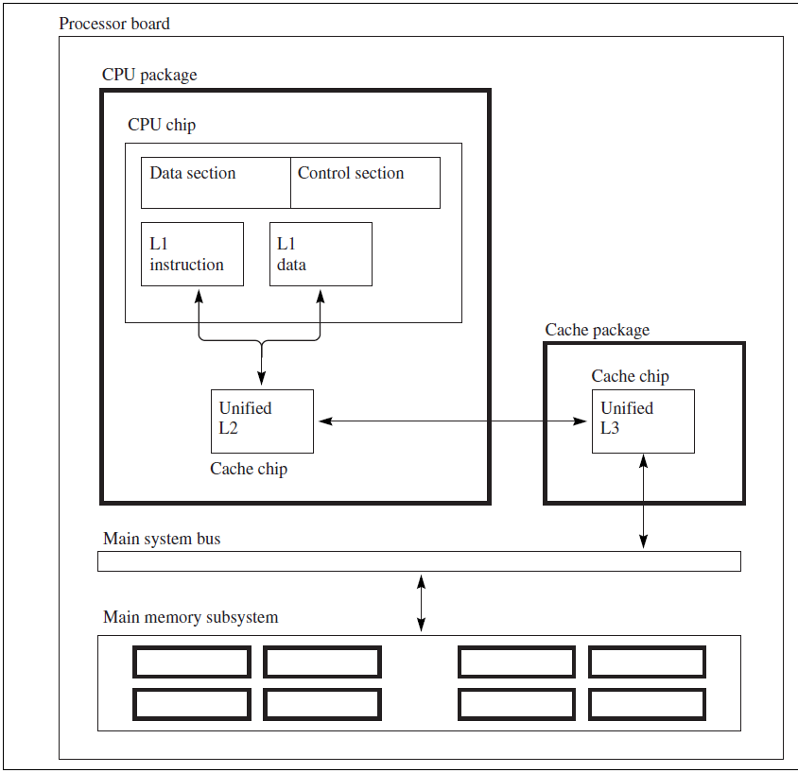
Cache Memory Levels
Three levels of cache are common
  Split L1 instruction and data cache on the CPU chip
  Unified L2 cache in the CPU package
  Unified L3 cache on the processor board
Notes:
Three levels of cache are common
Split L1 instruction and data cache on the CPU chip
Unified L2 cache in the CPU package
Unified L3 cache on the processor board

Slide 6
6.4 Cache Memory
Cache Memory Levels
Levels of cache form memory hierarchy
Level 1 cache (8KB to 64KB)
  On the processor itself
  Access time is about 4ns
Level 2 cache (64KB to 2MB)
  On the motherboard, or an expansion card
  Access time is about 15 - 20ns
Notes:
Most of today’s small systems employ multilevel cache hierarchies.
Level1 cache (8KB to 64KB) is situated on the processor itself.
Access time is typically about 4ns.
Level 2 cache (64KB to 2MB) may be on the motherboard, or on an expansion card.
Access time is usually around 15 - 20ns.
These sizes and times may be dated. Many of you reported your cache size and speed in a discussion question. You may want to refer back to that.

Slide 7
6.4 Cache Memory
Cache Memory Levels
Systems that employ three levels of cache:
Level 2 cache
  on same die as CPU
  reducing access time to about 10ns
Level 3 cache (2MB to 256MB)
  between processor and main memory
Notes:
In systems that employ three levels of cache, the Level 2 cache is placed on the same die (or chip) as the CPU (reducing access time to about 10ns)
Accordingly, the Level 3 cache (2MB to 256MB) refers to cache that is situated between the processor and main memory.

Slide 8
6.4 Cache Memory
Cache Memory
Purpose: to speed up accesses
  stores recently used data closer to the CPU
Cache
  Smaller than main memory
  Access time is a fraction of that of main memory.
Accessed by content
  often called content addressable memory
Single large cache memory isn’t always desirable-- it takes longer to search
Notes:
The purpose of cache memory is to speed up accesses by storing recently used data closer to the CPU, instead of storing it in main memory.
Although cache is much smaller than main memory, its access time is a fraction of that of main memory.
Unlike main memory, which is accessed by address, cache is typically accessed by content; hence, it is often called content addressable memory.
Because of this, a single large cache memory isn’t always desirable-- it takes longer to search.

Slide 9
6.4 Cache Memory
Cache Memory
Content addressed in content addressable cache memory
  subset of bits of a main memory address called a field
Fields
  provide a many-to-one mapping between larger main memory and the smaller cache memory
Many blocks of main memory map to a single block of cache
Tag field in cache block distinguishes one cached memory block from another
Notes:
The “content” that is addressed in content addressable cache memory is a subset of the bits of a main memory address called a field.
The fields into which a memory address is divided provide a many-to-one mapping between larger main memory and the smaller cache memory.
Many blocks of main memory map to a single block of cache. A tag field in the cache block distinguishes one cached memory block from another.

Slide 10
6.4 Cache Memory
Cache Memory Designs
There are two types of cache designs covered in the chapter
Direct-mapped cache
Set-associative cache
  Set-associative is derived from fully associative cache.
There is also a third type of cache
Fully Associative
  Found in exercises at the end of the chapter
Notes:
There are two types of cache designs covered in the chapter
Direct-mapped cache
Set-associative cache
Set-associative is derived from fully associative cache.
There is also a third type of cache
Fully Associative
This type of cache is not mentioned in the text however it is found in the exercises at the end of the chapter.

Slide 11
Direct-mapped Cache
Physical address is divided into three fields
A high-order tag field
A line field
A low-order byte field
Memory is divided into lines or blocks
If one byte is requested on a cache miss
  Entire line containing the byte
  loaded into cache
Notes:
Physical address is divided into three fields
A high-order tag field
A line field
A low-order byte field
Memory is divided into lines or blocks
When one byte is requested on a cache miss, the entire line containing the byte is loaded into the cache

Slide 12
6.4 Cache Memory
Direct-mapped Cache
Direct mapped cache
  N blocks of cache
  Block X of main memory maps to cache block
    Y = X mod N
Example:
  10 blocks of cache
  block 7 of cache may hold blocks
    7 or 17, 27, 37, . . . of main memory
valid bit is set for cache block
  lets the system know that the block contains valid data
Notes:
In a direct mapped cache consisting of N blocks of cache, block X of main memory maps to cache block Y = X mod N.
Thus, if we have 10 blocks of cache, block 7 of cache may hold blocks 7, 17, 27, 37, . . . of main memory.
Once a block of memory is copied into its slot in cache, a valid bit is set for the cache block to let the system know that the block contains valid data.

Slide 13
Fully-associative cache
Block can go anywhere in cache
Cache will fill up before any blocks are evicted
Memory address partitioned into two fields:
  tag
  word
Notes:
Instead of placing memory blocks in specific cache locations based on memory address, we could allow a block to go anywhere in cache.
In this way, cache would have to fill up before any blocks are evicted.
This is how fully associative cache works.
A memory address is partitioned into only two fields: the tag and the word.

Slide 14
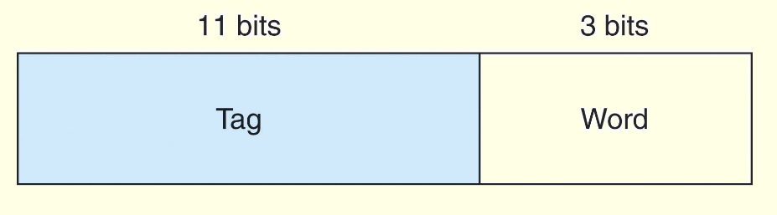
6.4 Cache Memory
Fully-associative cache
Example:
  14-bit memory addresses
  cache with 16 blocks, each block of size 8
  field format of memory reference is:
When cache is searched
  all tags searched in parallel to retrieve data quickly
Requires special, costly hardware
Notes:
Suppose, as before, we have 14-bit memory addresses and a cache with 16 blocks, each block of size 8. The field format of a memory reference is:When the cache is searched, all tags are searched in parallel to retrieve the data quickly.
This requires special, costly hardware

Slide 15
6.4 Cache Memory
Direct mapped cache
  evicts a block whenever another memory reference needs that block
Associative caches
  algorithm to determine which block to evict from cache
victim block
  block that is evicted
Many ways to pick a victim
Notes:
Direct mapped cache evicts a block whenever another memory reference needs that block.
With associative caches, we have no such mapping, thus we must devise an algorithm to determine which block to evict from the cache.
The block that is evicted is the victim block.

Slide 16
Set-associative cache
Set associative cache
  combines ideas of direct mapped cache and fully associative cache
N-way set associative cache mapping
  a memory reference maps to a particular location in cache (like direct mapped cache)
  a memory reference maps to a set of several cache blocks (like fully associative cache works)
memory reference can map only to the subset of cache slots
Notes:
Set associative cache combines the ideas of direct mapped cache and fully associative cache.
An N-way set associative cache mapping is like direct mapped cache in that a memory reference maps to a particular location in cache.
Unlike direct mapped cache, a memory reference maps to a set of several cache blocks, similar to the way in which fully associative cache works.
Instead of mapping anywhere in the entire cache, a memory reference can map only to the subset of cache slots.

Slide 17
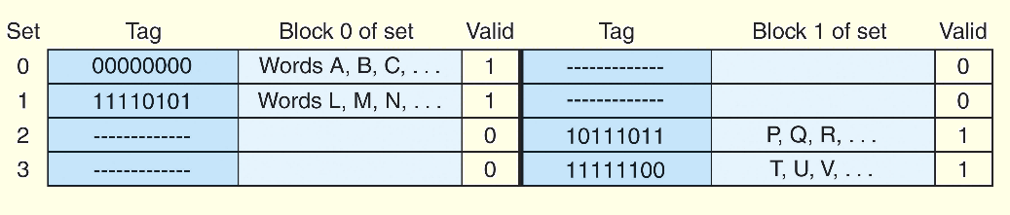
6.4 Cache Memory
Set-associative cache
Number of cache blocks per set
  varies according to system design
Example: 2-way set associative cache
  shown in schematic below
Each set contains two different memory blocks
Notes:
The number of cache blocks per set in set associative cache varies according to overall system design.
For example, a 2-way set associative cache can be conceptualized as shown in the schematic below.
Each set contains two different memory blocks.

Slide 18

6.4 Cache Memory
Set-associative cache
Set associative cache mapping:
  memory reference divided into three fields:
  tag, set (line), and byte (or word),
  Byte field chooses byte within cache block
  Tag field uniquely identifies memory address
Set (line) field determines set to which the memory block maps.
Notes:
In set associative cache mapping, a memory reference is divided into three fields: tag, set (line), and byte (or word), as shown below.
As with direct-mapped cache, the byte field chooses the byte within the cache block, and the tag field uniquely identifies the memory address.
The set (line) field determines the set to which the memory block maps.

Slide 19
Associative caches
Fully associative and Set associative cache
  replacement policy is invoked when needed to evict a block from cache
optimal replacement policy
  look into the future to see blocks not needed for the longest period of time
Impossible to implement an optimal replacement algorithm
  use as benchmark for assessing efficiency of any other scheme we come up with
Notes:
With fully associative and set associative cache, a replacement policy is invoked when it becomes necessary to evict a block from cache.
An optimal replacement policy would be able to look into the future to see which blocks won’t be needed for the longest period of time.
Although it is impossible to implement an optimal replacement algorithm, it is instructive to use it as a benchmark for assessing the efficiency of any other scheme we come up with.

Slide 20
6.4 Cache Memory
Associative caches
Replacement policy chosen
  depends upon locality to optimize
  usually interested in temporal locality
Least Recently Used (LRU) algorithm
  Tracks last time block was accessed
  Evicts the block that has been unused for the longest period of time
  Disadvantage of this approach is complexity
    LRU has to maintain access history for each block
    which ultimately slows down the cache
Notes:
The replacement policy that we choose depends upon the locality that we are trying to optimize-- usually, we are interested in temporal locality.
A least recently used (LRU) algorithm keeps track of the last time that a block was accessed and evicts the block that has been unused for the longest period of time.
The disadvantage of this approach is its complexity: LRU has to maintain an access history for each block, which ultimately slows down the cache.

Slide 21
6.4 Cache Memory
Associative caches
First-in, first-out (FIFO)
  popular cache replacement policy
  block in the cache the longest
  regardless of last used
Random replacement policy
  picks block at random and replaces with new block
  Can certainly evict a block that will be needed often or needed soon
Notes:
First-in, first-out (FIFO) is a popular cache replacement policy.
In FIFO, the block that has been in the cache the longest, regardless of when it was last used.
A random replacement policy does what its name implies: It picks a block at random and replaces it with a new block.
Random replacement can certainly evict a block that will be needed often or needed soon.

Slide 22
6.4 Cache Memory
Replacement Policies
Dirty blocks
  blocks updated while in cache
  must be written back to memory
  A write policy determines how
Two types of write policies
  write through
  write back
Notes:
Cache replacement policies must also take into account dirty blocks, those blocks that have been updated while they were in the cache.
Dirty blocks must be written back to memory. A write policy determines how this will be done.
There are two types of write policies,write through and write back.

Slide 23
6.4 Cache Memory
Replacement Policies
Write through
  Updates cache and main memory simultaneously on every write
  Disadvantage:
    memory must be updated with each cache write
    slows down the access time on updates
    usually negligible - majority of accesses usually reads not writes
Write back or copyback
    Updates memory only when block is selected for replacement
  Advantage:
    memory traffic is minimized
  Disadvantage:
    memory does not always agree with the value in cache causes problems in systems with many concurrent users
Notes:
Write through updates cache and main memory simultaneously on every write.
The disadvantage of write through is that memory must be updated with each cache write, which slows down the access time on updates. This slowdown is usually negligible, because the majority of accesses tend to be reads, not writes.
The advantage of write back (also called copyback) is that it updates memory only when the block is selected for replacement. The advantage is that memory traffic is minimized. However, a disadvantage is that memory does not always agree with the value in cache, causing problems in systems with many concurrent users.

Slide 24
6.4 Cache Memory
Alternative Caches
Unified or integrated cache
  Cache discussed previously
  Instructions and data are cached together
Harvard cache
  Separate caches for data and instructions.
  Provides better locality
  Greater complexity
  Larger cache
    provides about the same performance improvement
    without complexity
Notes:
The cache we have been discussing is called a unified or integrated cache where both instructions and data are cached.
Many modern systems employ separate caches for data and instructions.
This is called a Harvard cache.
The separation of data from instructions provides better locality, at the cost of greater complexity.
Simply making the cache larger provides about the same performance improvement without the complexity.

Slide 25
6.4 Cache Memory
Alternative Caches
Victim Cache
  add small associative cache to hold blocks that have been evicted recently
Trace cache
  variant of an instruction cache
  holds decoded instructions for program branches
  Gives illusion that noncontiguous instructions are really contiguous
Notes:
Cache performance can also be improved by adding a small associative cache to hold blocks that have been evicted recently.
This is called a victim cache.
A trace cache is a variant of an instruction cache that holds decoded instructions for program branches, giving the illusion that noncontiguous instructions are really contiguous.
Thanks for listening. Please review the presentations on Chapter 8 and 9 also before taking the quiz.

